Slide 1
What Is Prayer ?
A Brief Theology Of Prayer

Slide 2
What Is Prayer?
Prayer is God's verbal channel of communication between believers (in Jesus Christ) and Himself – through which His heavenly glory, will , blessings, power and provision (His Lordship and Saving Power) are being brought into active reality on earth.
Christian prayer is to the Father, in the Name of Jesus, through the power of the Holy Spirit.

Slide 3
To The Father…
Our Father who is in heaven…. (Matthew 6:9)
I bow my knees before the Father (Ephesians 3:14)
Giving thanks always for everything to God the Father (Ephesians 5:20, Colossians 1:12, 3:17)
Abba Father (Mark 14:36, Romans 8:15, Galatians 4:6)
The Father … from Whom are all things (1 Corinthians 8:6)
The Father of mercies and God of all Comfort (2 Corinthians 1:3)
The eternally blessed One..the God and Father of our Lord Jesus Christ (2 Corinthians 11:31)
The Father…who has blessed us with every blessing in the heavenly realms (Ephesians 1:3)
Every generous act and perfect gift is from above coming down from the Father of lights (James 1:17)
Father of spirits (Hebrews 12:9)

Slide 4
In The Name Of Jesus
Jesus Christ the Mediator between God and Man (1 Timothy 2:5, Hebrews 8:6, 9:15, 12:24)
When two or three are gathered in My Name there I am in the midst of them (Matthew 18:20)
Whatever you ask in My name I will do it … (John 14:13,14)
..whatever you ask the Father in My name He will give you (John 15:16, 16:23-26)
Calling on the name of the Lord for salvation (Acts 2:21, 4:12,10:43 Romans 10:13, 1 Corinthians 1:2, 6:11)
Signs and wonders (Acts 3:6, 4:30)
Faith in His name (John 1:12, 20:31, Acts 3:16)
Exorcism (Acts 16:18,19:13-17)
Healing (James 5:14)
Worship & service in His name (Philippians 2:10, Hebrews 6:10, 13:15)

Slide 5
Through The Holy Spirit
The Holy Spirit helps us in our praying (Romans 8:26)
The Spirit gives life to our prayers (John 6:63)
The Holy Spirit gives us access to the Father (Ephesians 2:18, 3:12)
We need to be born-again as a new creation by the Holy Spirit to really know spiritual life (John 3:3-8, 2 Corinthians 3:13-18, 5:17, )
Believers are ‘one spirit’ with God (1 Corinthians 6:17)
The Holy Spirit gives some believers a heavenly prayer language (Acts 2:3,4 ; Acts 10:44-48, 19:6, 1 Corinthians 12:10,28,30; 14:1-40)

Slide 6
Posture
It does not involve any special required place or posture - though kneeling, raising of hands, laying on of hands and lying prostrate before the Lord get a few mentions each.
Kneeling: Luke 22:41, Acts 7:60, 9:40, 20:36, 21:15, Ephesians 3:14
Laying On Of Hands: Matthew 19:15, Mark 6:5, 8:23-25, 10:16, 16:18; Luke 4:40, Acts 6:6, 8:17,18; 13:3, 19:6, 28:8, 1 Timothy 4:14, Hebrews 6:2
Lifting Up Holy Hands: Deuteronomy 32:40, Psalms 28:2, 63:4, 134:2, 141:2, Lamentations 3:41, Luke 24:50, 1 Timothy 2:8

Slide 7
What Prayer Is NOT!!
A Hypocritical Public Performance (Matthew 6:5,6)
Repetitive / Wordy (Matthew 6:7,8)
Unforgiving / Hard-Hearted (Matthew 6:12-15, 18:21-35; 1 Peter 3:7)
Boastful (Luke 18:9-14)
Full of conflict with others (1 Timothy 2:8)
Unbelieving / Filled With Doubt (James 1:5-8, Matthew 21:21, Mark 11:23)

Slide 8
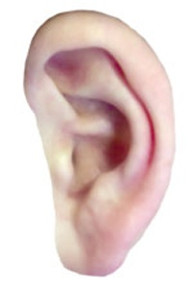
The Three Big Categories
ENFORCEMENT - exorcism, healing, cleansing lepers, raising the dead, acts of faith and power, intercession, imprecation, words of faith and testimony, crying out for justice and for God’s will to be done
ADORATION – praise, thanksgiving, worship, sitting in silence before the Lord, seeking God, knowing God’s love
REQUESTING – for forgiveness, escape from temptation, cleansing, spiritual growth, wisdom, power in ministry, daily bread and so on.

Slide 9
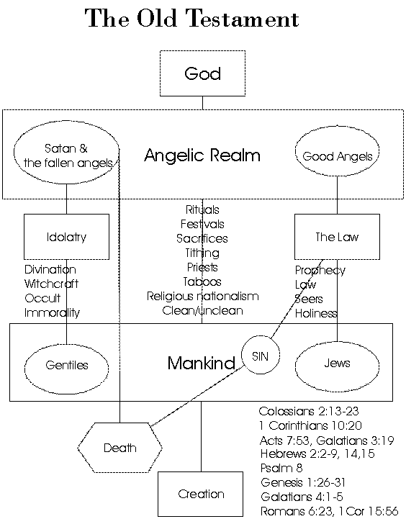

Slide 10
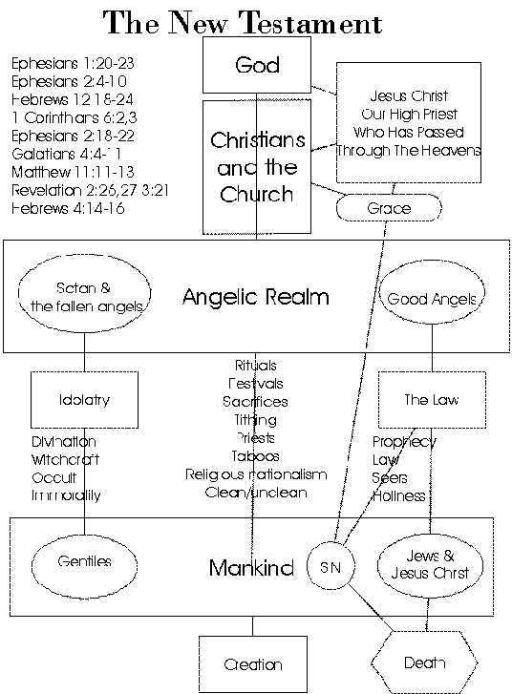

Slide 11
NT Enforcement
Casting out of demons
Healing: That which I have I give unto you, in the name of Jesus Christ of Nazareth, rise up and walk..”
Works of Faith: Moving mountains / nothing shall be impossible / all things are possible to them that believe
Binding and loosing: Forgiveness and remission of sins, church discipline etc.

Slide 12
NT Adoration
Veil of the temple torn in two
Access to the Father via the Holy Spirit
Love of God poured out into our hearts via the Holy Spirit
Daily transformation from glory to glory
Rejoicing in the Lord always
Your young men shall prophesy and your old men dream dreams…
Abundance of revelation as the Holy Spirit teaches us the things of God

Slide 13
NT Requesting
Anything you ask in My name (John 14:14,16:23)
If we ask anything according to His will… (1 John 5:14,15)
All things are yours…. (1 Corinthians 3:21-23)
Come boldly before the throne of grace in time of need (Hebrews 4:16)
Prayers for wisdom, spiritual insight and maturity (Ephesians 3:14-21)

Slide 14
Spiritual Senses
Spiritual Eyes: Ephesians 1:18; John 6:22,23; Matthew 13:13-17; Luke 24:31; John 12:35-41, Acts 26:18, Hebrews 12:2, Revelation 3:18
Spiritual Blindness: Matthew 23:14,16,17,19,24,26 John 9:39-41, Acts 28:27, 2 Corinthians 4:4, 2 Peter 1:9, 1 John 2:11, Revelation 3:17
Spiritual Ears: Acts 7:51, 28:27; Romans 11:18; Revelation 2:7,11,17,29; Matthew 11:15,13:9
These must be trained through use (Hebrews 5:14)
Jesus used them to know the Father’s will (John 5:19)

Slide 15
Using Our Spiritual Senses When We Pray
Luke 12:12
John 4:23,24
John 14:16,17; 15:26, 16:13
Acts 2:17,18
Acts 13:2
Acts 8:26-29
Acts 10:9-17
Acts 16:7-10

Slide 16
Discerning God’s Voice - 1
God’s voice always lines up with God’s word
God’s voice always lines up with the fruit of the Holy Spirit
God’s voice always lines up with the nature and the commandments of Jesus Christ
God’s voice may discipline but never totally condemns the believer in Jesus Christ.
God’s voice always directs us towards loving and righteous and fruitful ends

Slide 17
Discerning God’s Voice - 2
James 3:14-18 But if you have bitter jealousy and strife in your hearts, do not glory and lie against the truth. (15) This is not the wisdom coming down from above, but is earthly, sensual, devilish. (16) For where envying and strife are, there is confusion and every foul deed. (17) But the wisdom that is from above is first truly pure, then peaceable, gentle, easy to be entreated, full of mercy and good fruits, without partiality and without hypocrisy. (18) And the fruit of righteousness is sown in peace by those who make peace.

Slide 18
Discerning God’s Voice - 3
Galatians 5:19-26 Now the works of the flesh are clearly revealed, which are: adultery, fornication, uncleanness, lustfulness, (20) idolatry, sorcery, hatreds, fightings, jealousies, angers, rivalries, divisions, heresies, (21) envyings, murders, drunkennesses, revelings, and things like these; of which I tell you before, as I also said before, that they who do such things shall not inherit the kingdom of God.
(22) But the fruit of the Spirit is: love, joy, peace, long-suffering, kindness, goodness, faith, (23) meekness, self-control; against such things there is no law. (24) But those belonging to Christ have crucified the flesh with its passions and lusts. (25) If we live in the Spirit, let us also walk in the Spirit.
(26) Let us not become glory-seeking, provoking one another, envying one another.

Slide 19
Discerning God’s Voice - 4
1 John 2:9-11 The one who says he is in the light but hates his brother is in the darkness until now. (10) The one who loves his brother remains in the light, and there is no cause for stumbling in him. (11) But the one who hates his brother is in the darkness, walks in the darkness, and doesn't know where he's going, because the darkness has blinded his eyes.
Resentment, rejection and revenge create darkness in us, so that we cannot see God or pray correctly
Love creates light in us so that we come to know God and to pray effectively

Slide 20
Discerning God’s Voice - 5
GOD – FRUIT pure, peaceable, wise, gentle, full of love and the fruit of the Spirit, calm, unhurried, gracious, forgiving, inviting, promising, blessing
SATAN /FLESH– ENERGIES accusing, tempting, harassing, envying, striving, competing, demanding, alluring, adulterous, impatient, foolish, unwise, cursing, avenging, occult, magical, fear-creating, unforgiving, hard-hearted, tempestuous, denying.
SELF – ANXIETIES worries, fears, pompousness, self-centredness, ego, trivial concerns, self-absorption, no peace, inability to rely on God or trust in His goodness and faithfulness

Slide 21
Praying With Power!
1 John 5:14-15 Now this is the confidence we have before Him: whenever we ask anything according to His will, He hears us. (15) And if we know that He hears whatever we ask, we know that we have what we have asked Him for.
Get into God’s will
Ask
Listen For God
Pray further based on the response that you receive
Be confident that God has heard you
Believe that you have received.

